Slide 1
Call Center Performance Optimization:
A Monte Carlo Approach
CSE718
Fall-2023
Group 11
Group Members-
Name | ID
Nazifa Khanom | 22166009
Mashfurah Afiat | 23366039
Tahmid Zarif Ul Hoq Sayor | 23266015
Alvin Rahul Hore | 23166005
ST- Mehnaz Ara Fazal
RA- Humaion Kabir Mehedi
Course Instructor:
Annajiat Alim Rasel
Senior Lecturer,Department of Computer Science and Engineering,BRAC University

Slide 2
INTRODUCTION
A call center is a centralized division that answers incoming and outgoing calls from clients, both present and prospective. Its purpose is to enhance customer happiness, communication, and operational effectiveness.
There are both chances and problems in the call center setting when it comes to simulating things like customer queuing systems, agent versus electronic channel usage, load analysis, scheduling effects, process redesign, executive studying, and other similar things.

Slide 3
INTRODUCTION
In this study, we utilise Monte Carlo simulation and Random Forest modelling to address the dynamic challenges within call centre operations. Monte Carlo simulation allows us to model the inherent uncertainties and complexities, providing insights into optimising performance.
We conduct simulations with the primary goal of customer retention, aiming to enhance our engagement strategies and prevent customer attrition. Through an iterative improvement process, we are dedicated to refining and optimising our simulation methodologies.

Slide 4
BACKGROUND
Call centers serve as central hubs for customer interactions, handling both inbound and outbound communication channels. The significance of call centers lies in their contribution to customer satisfaction, effective issue resolution, and overall operational efficiency.
In the contemporary business landscape, call centers are faced with multifaceted challenges influenced by varying operational scenarios. These scenarios encompass factors such as fluctuating call volumes, diverse customer inquiries, and the dynamic nature of agent availability. Understanding how these operational scenarios impact key performance indicators (KPIs) is imperative for call center management to optimize their performance.

Slide 5
BACKGROUND
Also the complexity and uncertainties inherent in call center operations was recognized..The need to model and analyze these uncertainties becomes apparent, and this forms the basis for introducing the Monte Carlo simulation approach. The Monte Carlo method provides a powerful tool for simulating diverse operational conditions, allowing for a comprehensive exploration of the intricate dynamics within call centers.
As call centers continue to evolve in response to technological advancements and changing customer expectations, a strategic and data-driven approach becomes essential and for that we focus on leveraging the Monte Carlo approach to model uncertainties and optimize call center performance. It underscores the importance of advancing simulation techniques to address the challenges posed by varying operational scenarios, ultimately contributing to the enhancement of customer service and operational efficiency in call center environments.

Slide 6
PROJECT IDEAS
Simulating Calls for the Call Center
Assigning Calls to Call Receiver Agents
Handling Calls and Queue Management
Determining Call Centre Service Quality

Slide 7
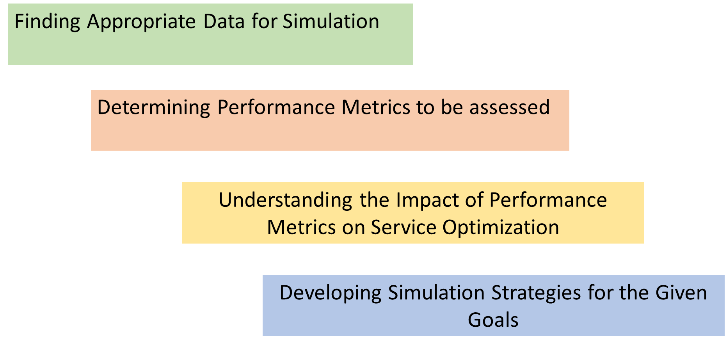
PROJECT PLANS

Slide 8
POTENTIAL CHALLENGES
Computational Intensity: Max limit of queue above 10000 may result in slowing the algorithm.
Model Complexity: Building an accurate simulation model for a call center involves few features intricacies which can be challenging, and inaccurate models may lead to suboptimal results.
Overfitting Random Forest: Overfitting may result in a model that performs well on the training data but fails to generalize effectively to new, unseen data and decrease the model’s accuracy level.
Scalability: Depending on the size of the call center and the volume of data, training and deploying a random forest model could be resource-intensive.

Slide 9
CONCLUSION
In conclusion, this paper delves into the intricacies of call center operations with a focus on performance optimization using a Monte Carlo approach
The main goal being customer retention, the primary objective of our simulations is to refine engagement strategies and mitigate customer attrition
The project ideas outlined to achieve optimal performance
Overcoming Potential Challenges
Integration of Monte Carlo simulation and Random Forest modeling - a strategic imperative for enhancing customer service and operational efficiency.

